Slide 1
Partnering with Parents
Kids at Church

Slide 2
Partnering with Parents
Kids at Church
Thank you for…

Slide 3
Partnering with Parents
Kids at Church
Thank you for…
waiting patiently until the kids return! ☺

Slide 4
Partnering with Parents
Kids at Church
Thank you for…
waiting patiently until the kids return! ☺
taking responsibility of your children after the service. ☺

Slide 5
Partnering with Parents
Kids at Church
Thank you for…
waiting patiently until the kids return! ☺
taking responsibility of your children after the service. ☺
working through any take-home goodies the kids get. ☺

Slide 6
Partnering with Parents
Kids at Church
Helping children follow Jesus for life!
Thank you for…
waiting patiently until the kids return! ☺
taking responsibility of your children after the service. ☺
working through any take-home goodies the kids get. ☺

Slide 7
People who meet Jesus…
Kids at Church

Slide 8
People who meet Jesus…
10 Lepers
Deaf and Mute man
Widow from Nain
Gentile Woman
Kids at Church

Slide 12
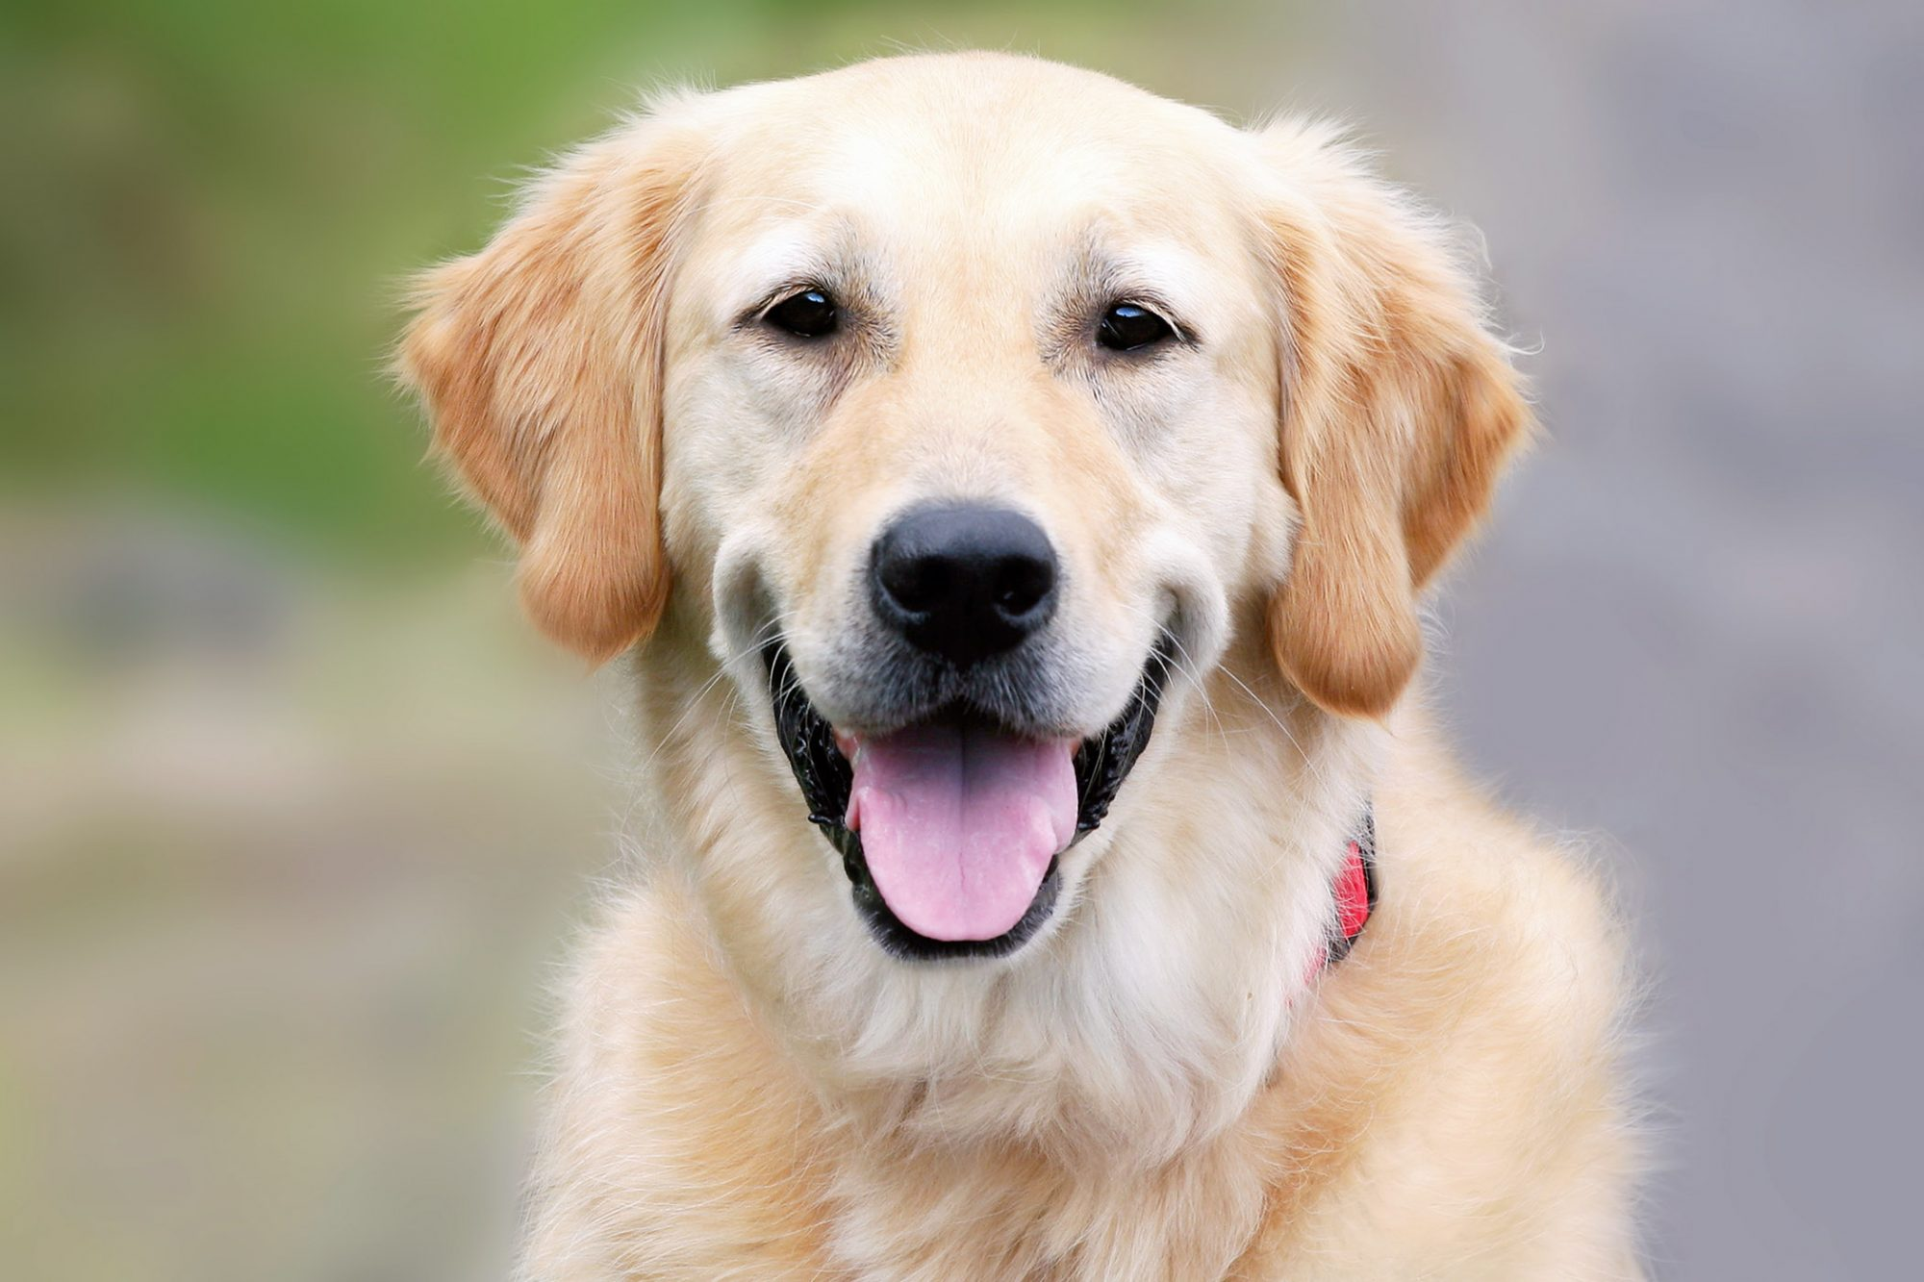

Slide 14
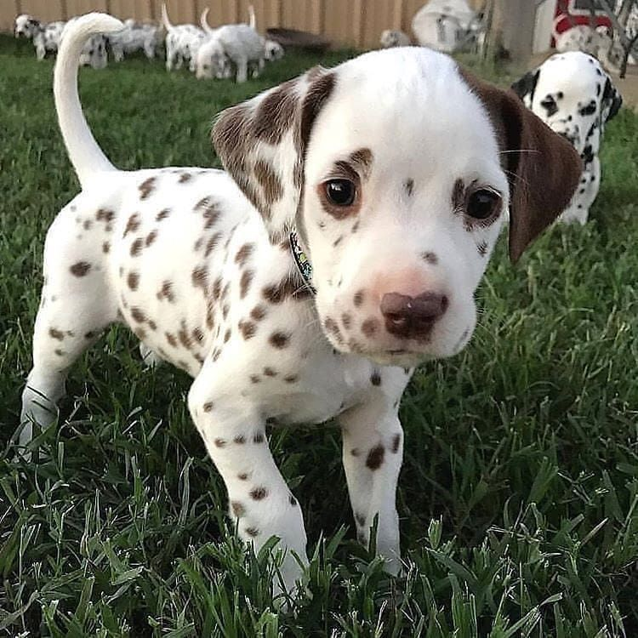

Slide 16
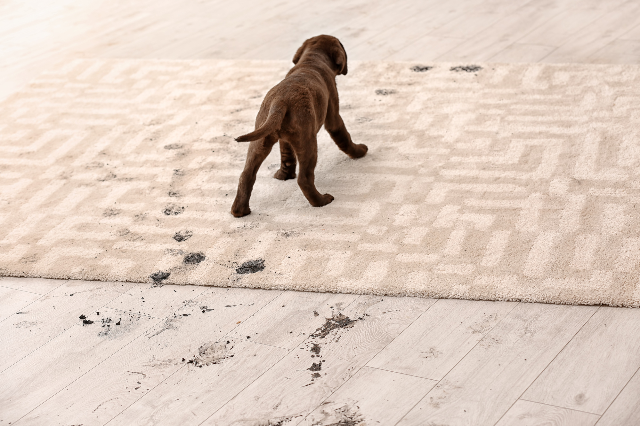

Slide 17
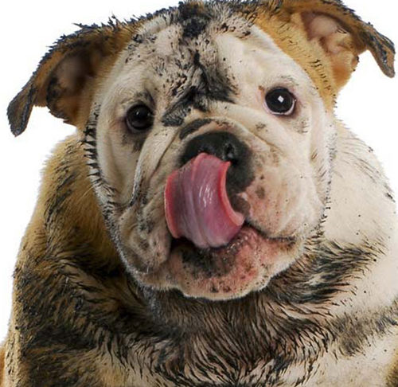

Slide 18
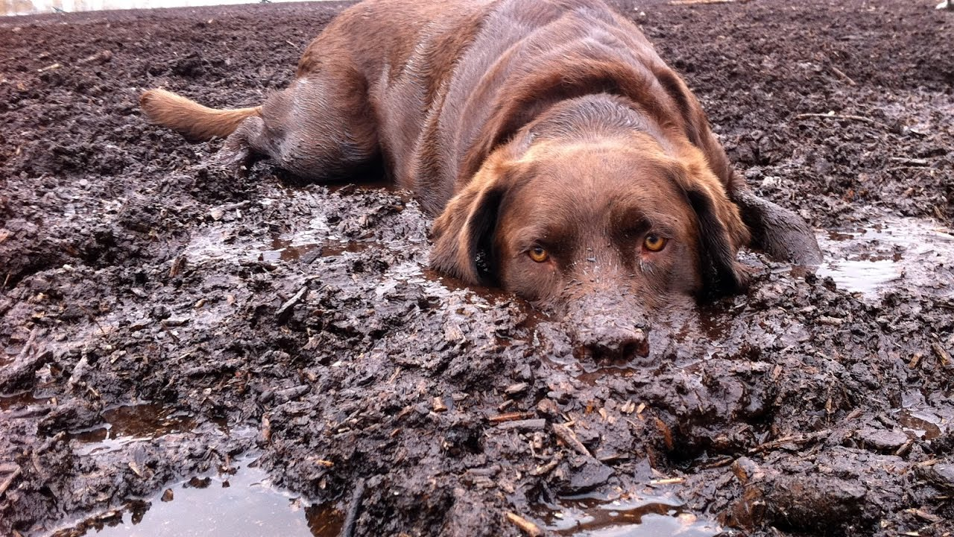

Slide 19
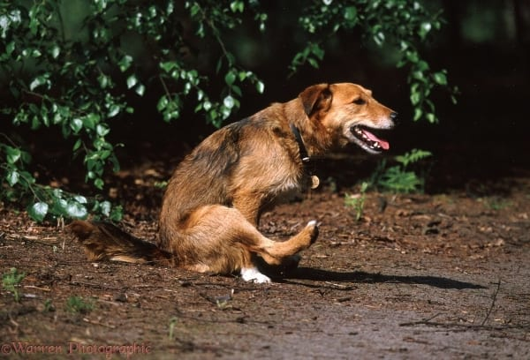
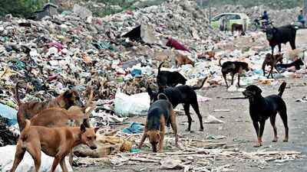

Slide 20
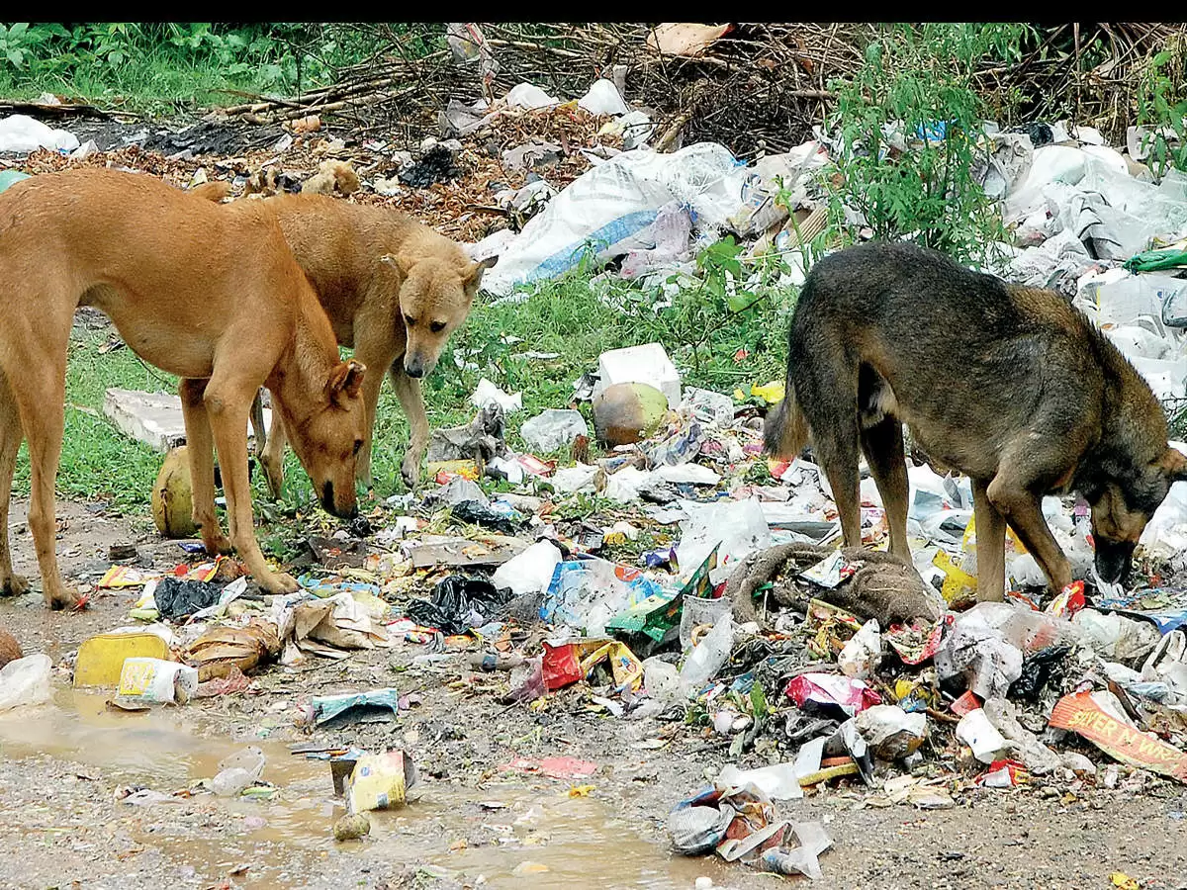

Slide 21
God’s holy people “clean”, Israel.
All the other people, “unclean”, Gentiles.

Slide 22
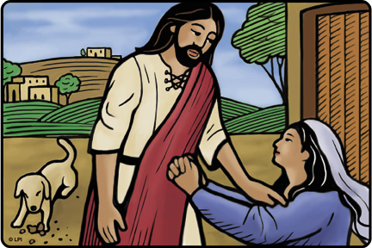

Slide 23
“Jesus Son David, have mercy on me!”

Slide 24
“It is not right to take the children’s bread and toss it to the dogs.”

Slide 25
“Even the dogs eat the crumbs that fall from their master’s table”

Slide 26
“ Woman, you have great faith! Your request is granted.”

Slide 27
It doesn’t matter who you are, or what your background is, God loves you, all that matters is having faith in Jesus!

Slide 29
Sin

Slide 30
God’s holy people “clean”, Israel.
All the other people, “unclean”, Gentiles.

Slide 31
God’s holy people “clean”, Israel.
All the other people, “unclean”, Gentiles.

Slide 32
The Gentile Woman
Persistent,
humble,
faith
in Jesus!

